Slide 1
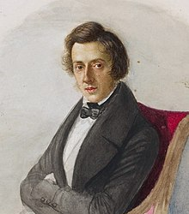
Fryderyk Chopin
Composer
1910-1849
To zdjęcie, autor: Nieznany autor, licencja: CC BY-SA

Slide 2
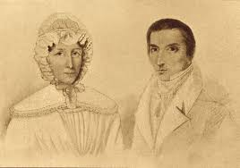
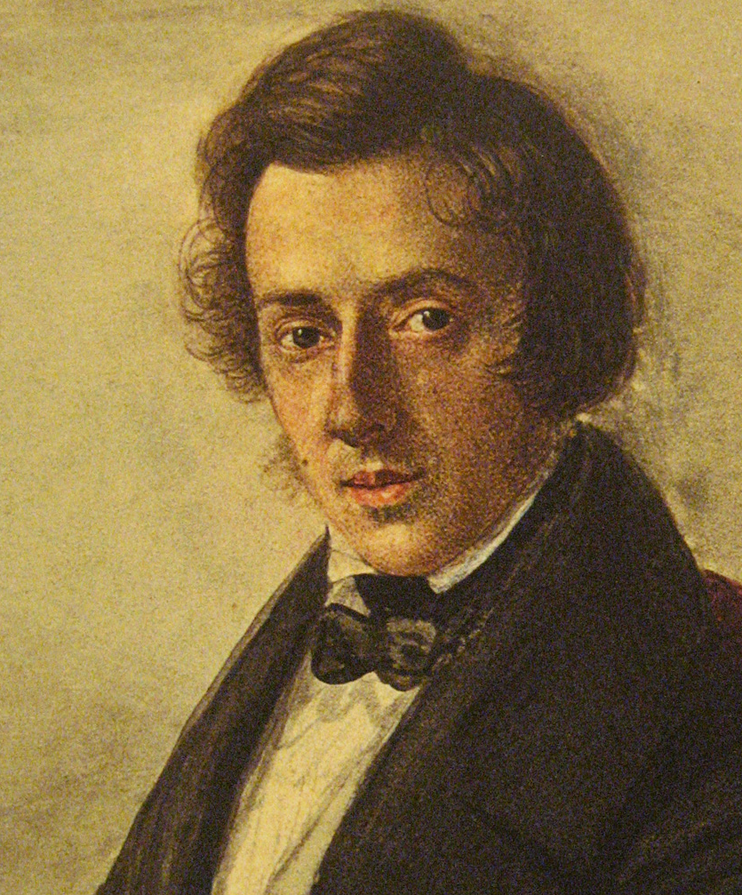
He was born on February 22 in Żelazowa Wola. He was the son of Mikołaj and Justyna
To zdjęcie, autor: Nieznany autor, licencja: CC BY-NC-ND

Slide 3
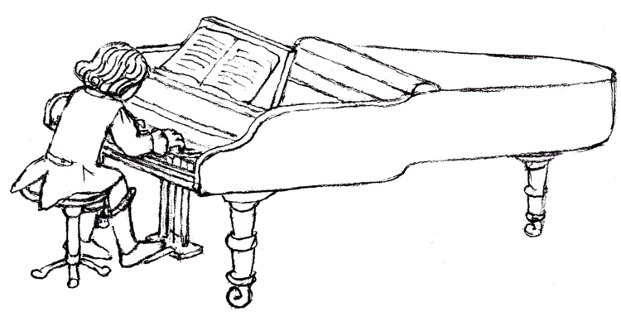
When he was 7 years old he composed his first song, which his father wrote. This work is called "Polonez B-dur’’ He started playing the piano when he was 4-5 years old

Slide 4
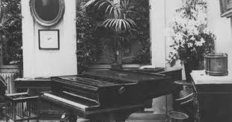
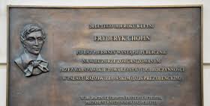
On February 24, 1818, the first public concert of Fryderyk took place in the Radziwiłł Palace

Slide 5
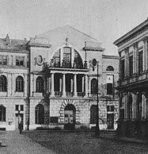
In the years 1823-1826 Chopin studied at the Warsaw Lyceum, where his father worked In the years 1826-1829 he was a student at the Warsaw School of Music, where he began to study harmony and counterpoint with Józef Elsner

Slide 6
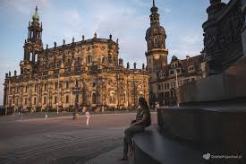
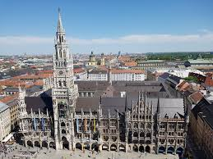
On November 5, 1830, Chopin left Poland forever. He went to Drezna, then to Monachium and finally to Paris
Drezno
Monachium
Paris

Slide 7
After the outbreak of the revolution in Paris in 1848, he went to England and Scotland for a very exhausting journey. On November 16, his last public concert took place in London.

Slide 8
Frederick returned to France. His health got worse. Chopin died surrounded by several people close to him about 2 on the night of October 17, 1849. As a cause, the doctor entered tuberculosis. He was buried in Paris
To zdjęcie, autor: Nieznany autor, licencja: CC BY-SA

Slide 9
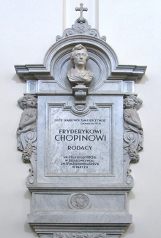
His heart was brought to Poland in January 1850 and placed in the church of the Holy Cross in Warsaw

Slide 10
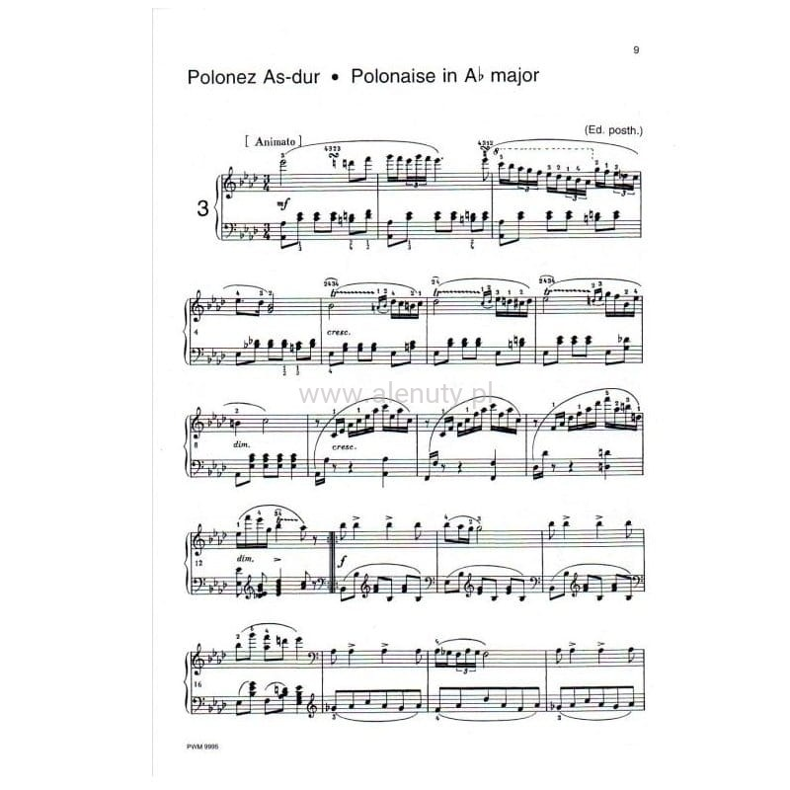
Fryderyk Chopin composed: 57 mazurkas, 19 waltzes, 16 polonaises, 19 nocturnes, 4 ballads, 4 scherzos, 3 piano sonatas, 26 preludes, 27 etudes and many other works

